Slide 1
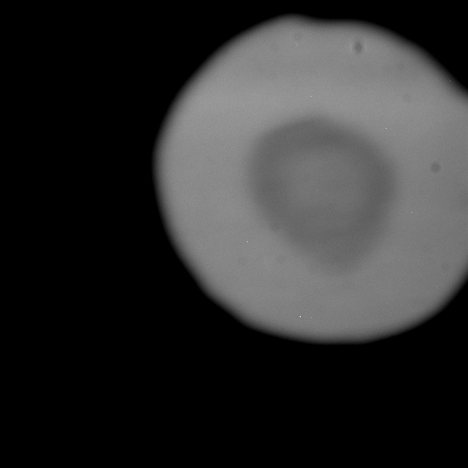
FO72b 53 GPa before Alastair’s improvement 2 April 2010 ALS 12.2.2
Notes:
FO72b before heating 53 GPa

Slide 2
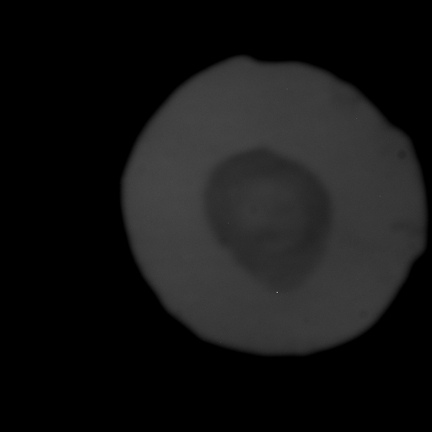
FO73b, after resolution improvement, before heating
[Move phosphor closer to DAC]
Notes:
FO72b before heating after resolution improved

Slide 3
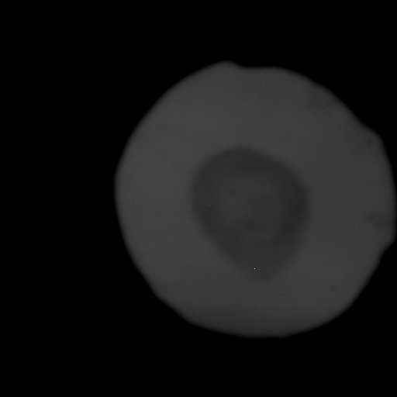
Notes:
1 and heating target spot

Slide 4
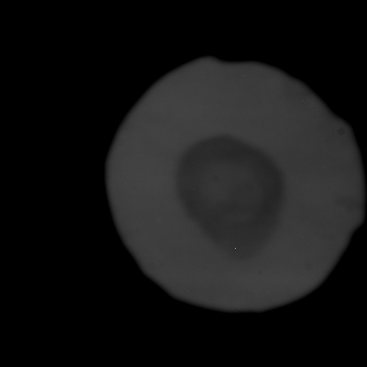
Notes:
2

Slide 5
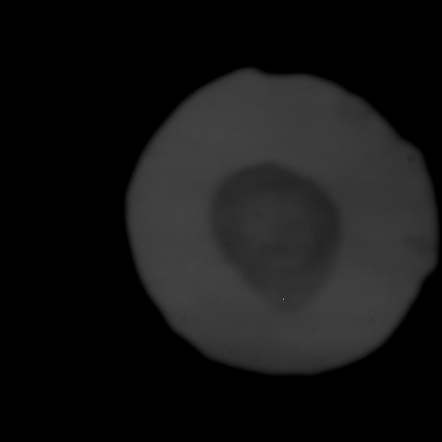
Notes:
3

Slide 6
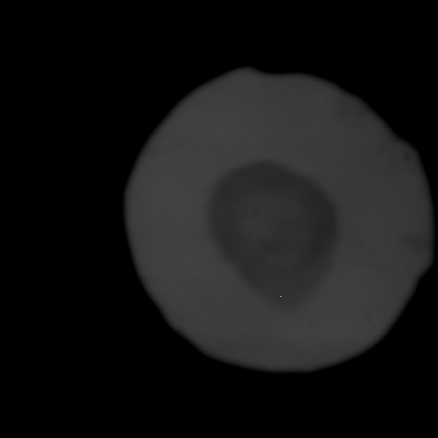
Notes:
4

Slide 7

Notes:
5

Slide 8
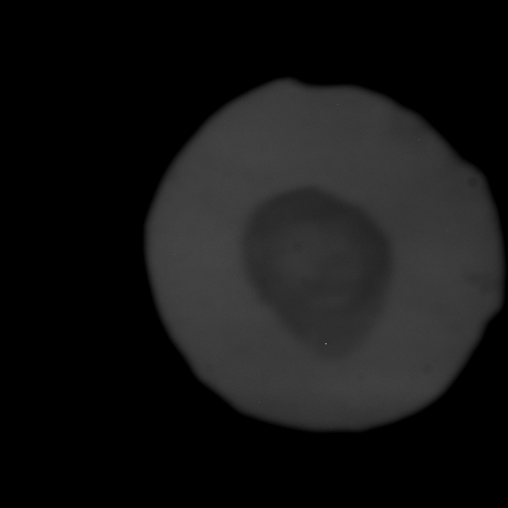
Notes:
6

Slide 9
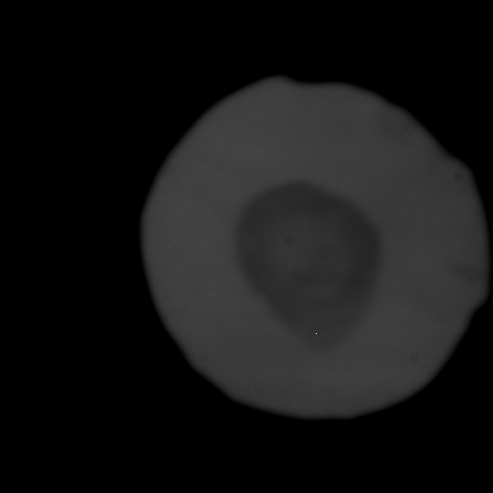
Notes:
7

Slide 10
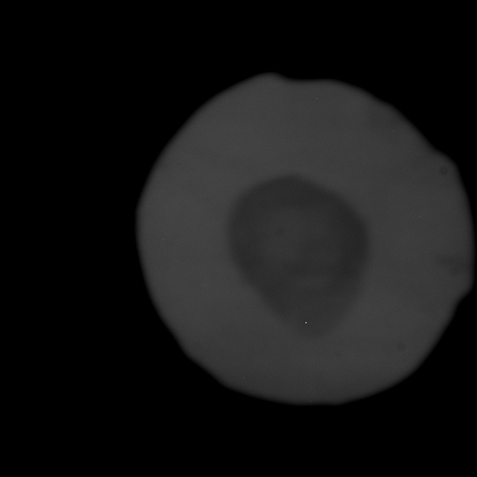
Notes:
8

Slide 11
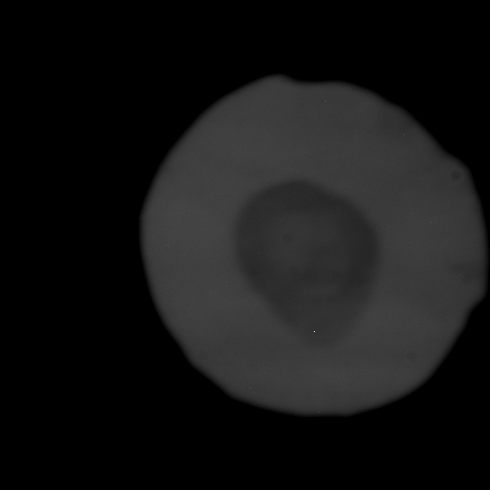
Notes:
9

Slide 12
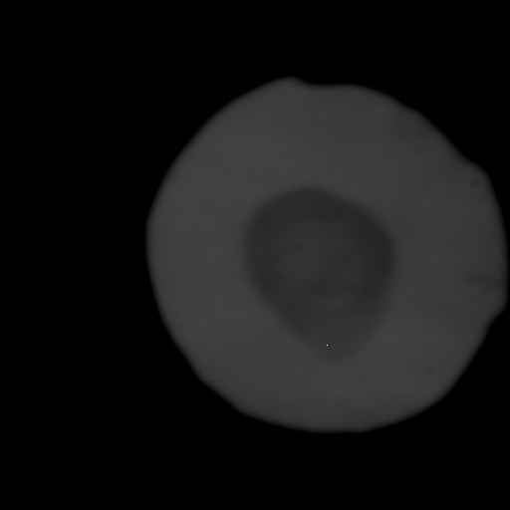
Notes:
10

Slide 13
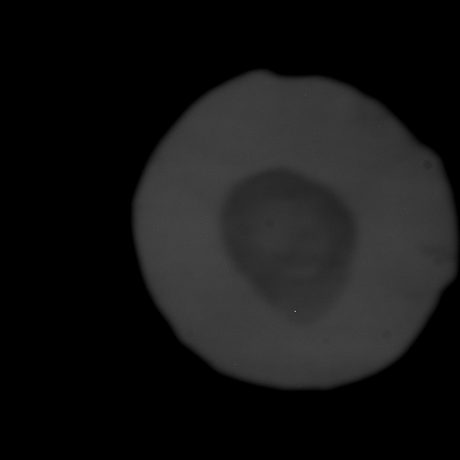
Notes:
11

Slide 14
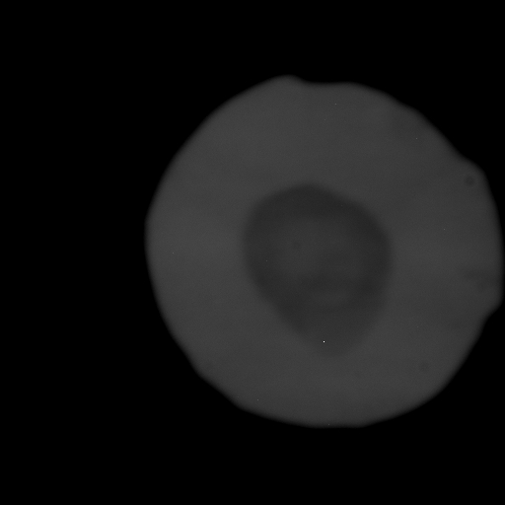
Notes:
12

Slide 15
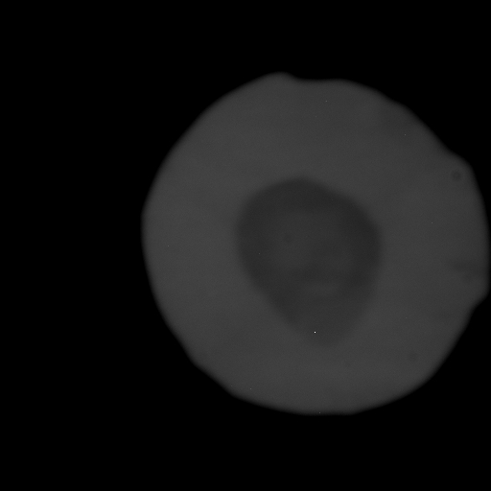
Notes:
13

Slide 16
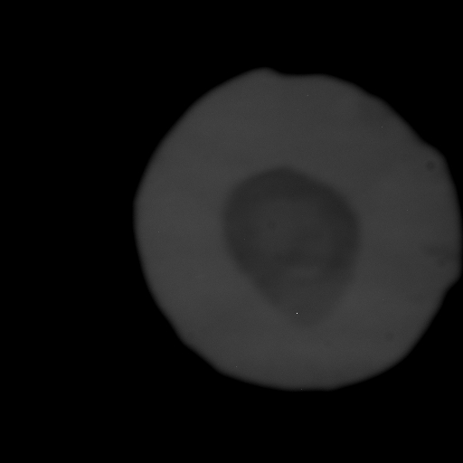
Notes:
14

Slide 17
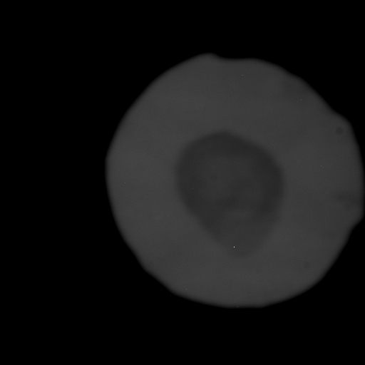
Notes:
15

Slide 18
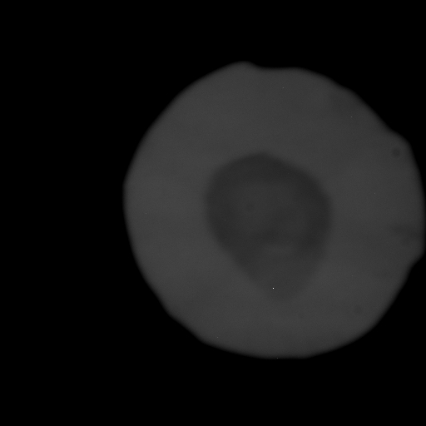
Notes:
16

Slide 19
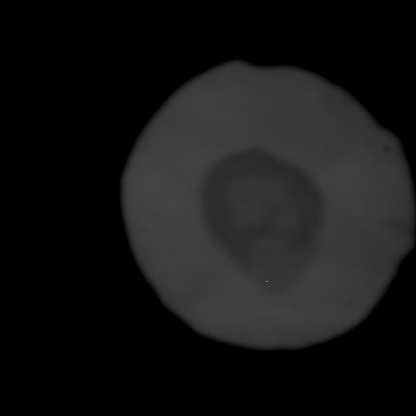
Notes:
17

Slide 20

Notes:
18

Slide 21

Notes:
19

Slide 22

Notes:
20

Slide 23
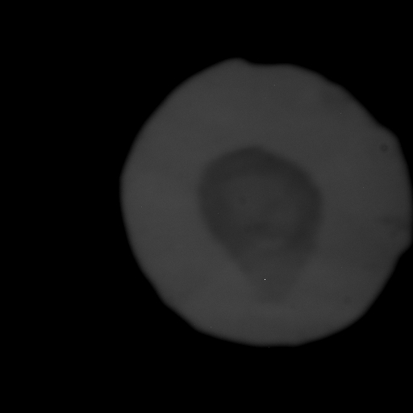
Notes:
21

Slide 24
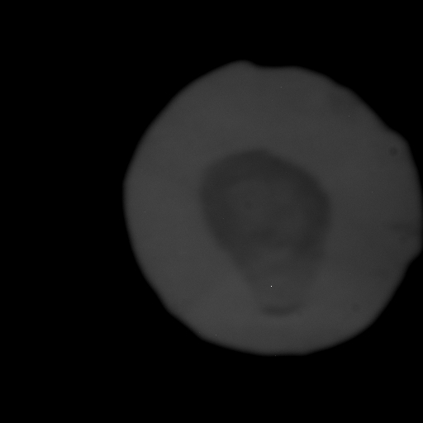
Notes:
22 skull screams

Slide 25
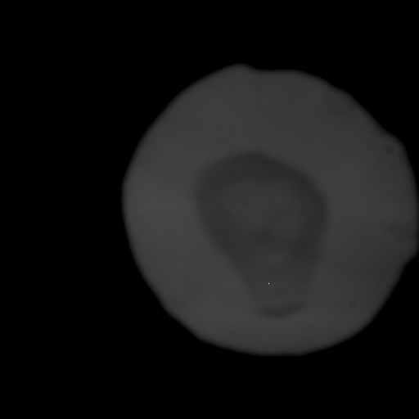
Note whole image response instead of just target laser spot.
Is it ledging or squidging?
Notes:
23

Slide 26
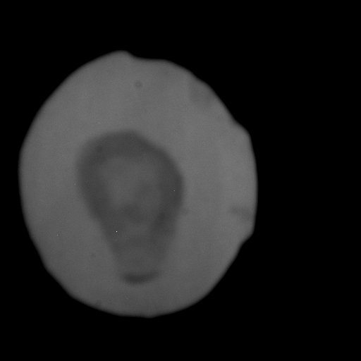
After quenching and P = 51.5 GPa measurement
Notes:
24 quenched rotated

